Slide 1
Waterborne Polio Detection
Designer BAAKteria
Kathryn Atherton, Archana Kikla, Barbara McAnulty, Adrian Ortiz-Velez
Notes:
Archana

Slide 2
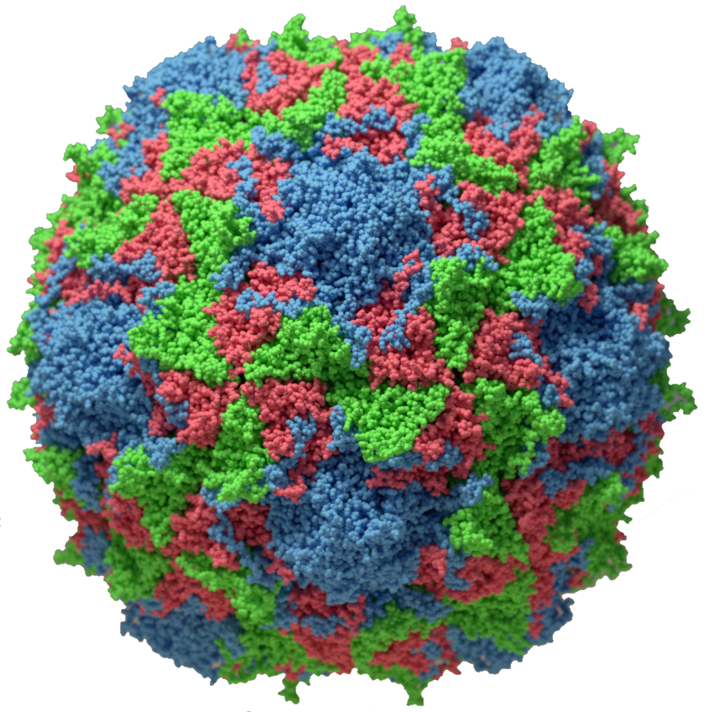
Overview
Vaccine developed in 1955
Afghanistan, Pakistan, Nigeria, still fighting polio endemic ²
CDC categorized as a Level 2 Hazard to travelers
Biosafety bill signed into law April 2015 ³
Due to Nigeria’s open-mindedness toward biotechnology solutions, we plan to use synthetic biology to tackle the problem of the Nigerian polio endemic.
Polio is a crippling disease which attacks the nervous system and is spread through contact with the feces of an infected person or drinking water or eating food contaminated with infected feces. ¹
http://www.virology.ws/wp-content/uploads/2016/08/poliovirus-copy.png
Notes:
Archana

Slide 3
Design
Notes:
Archana

Slide 4
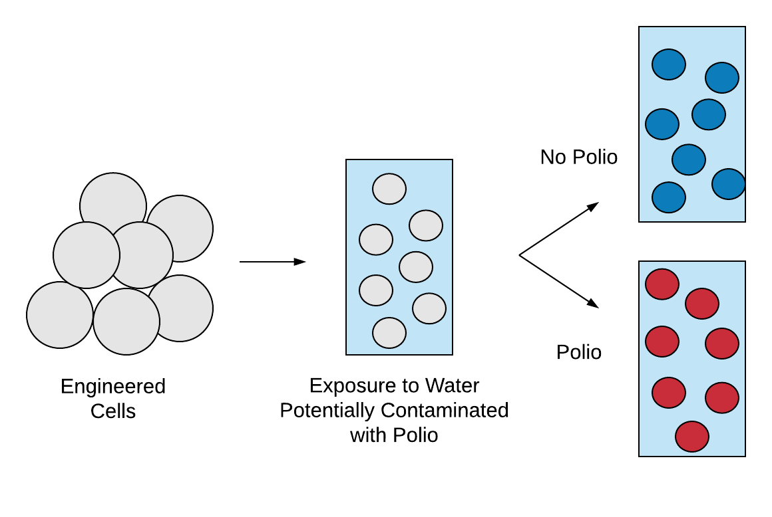
Ideal design: In-home Poliovirus Biosensor
Notes:
Archana

Slide 5
Design Specifications
User-friendly: must be able to be used and understood by people without any training and can be performed at home without uncommon equipment
Fast: report results in under one hour
Positive and negative results: create some form of signal for both detection of polio and absence of polio
Accessible to majority of population: easy to understand results and accessible to color-blind
Notes:
Archana

Slide 6
Chassis
Hierarchical Design
Device
System
Parts
DNA
Notes:
Archana

Slide 7
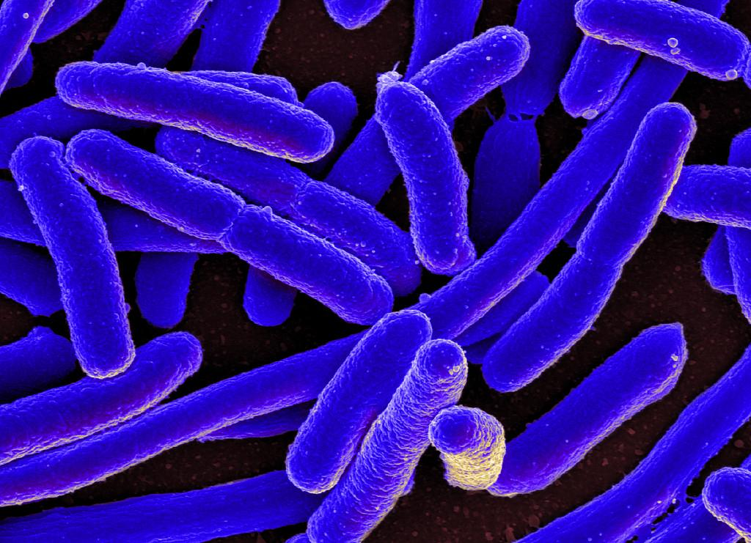
Chassis
E. coli with polio receptor membrane protein
Notes:
Barbara

Slide 8
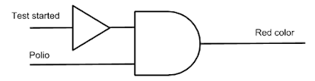
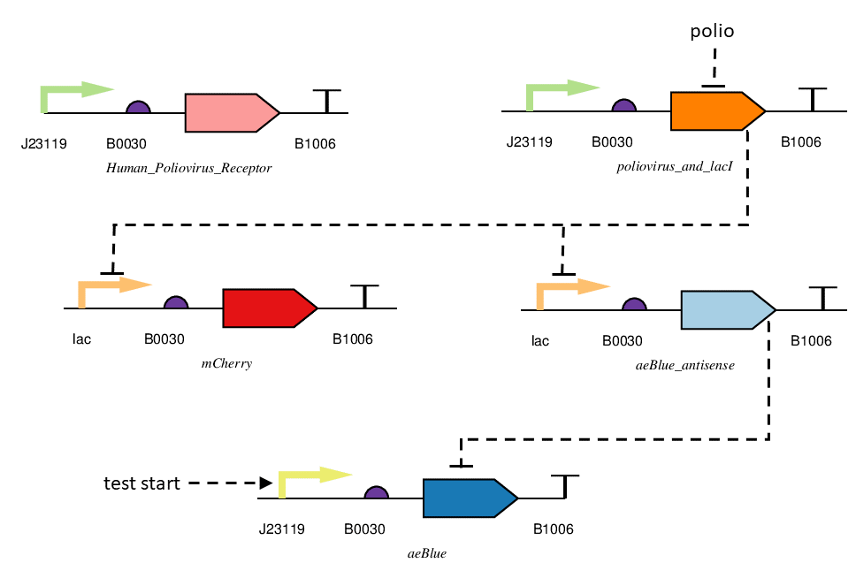
Device
Notes:
Katie

Slide 9
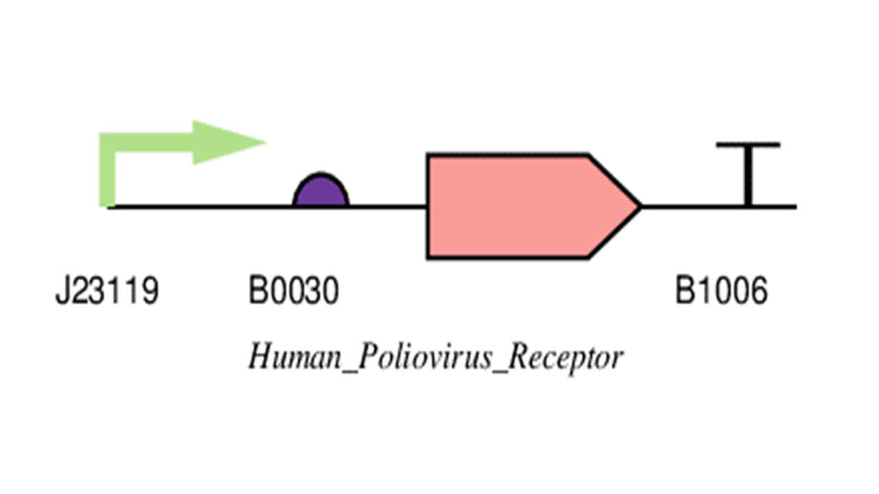
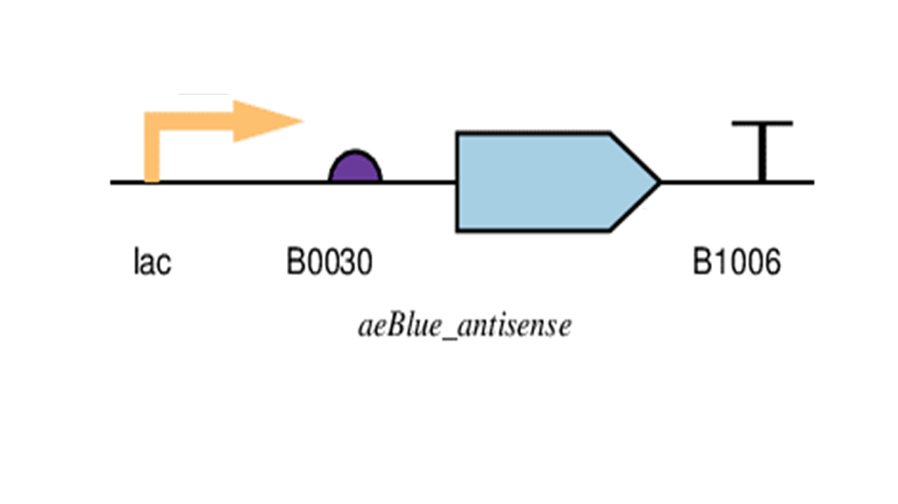
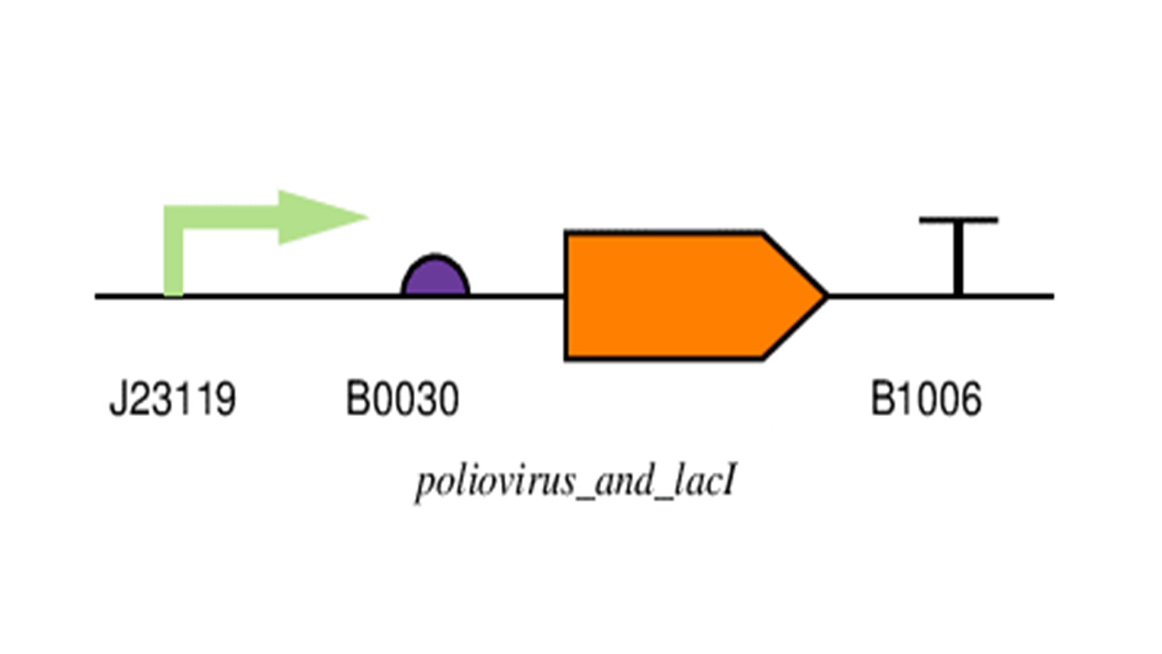
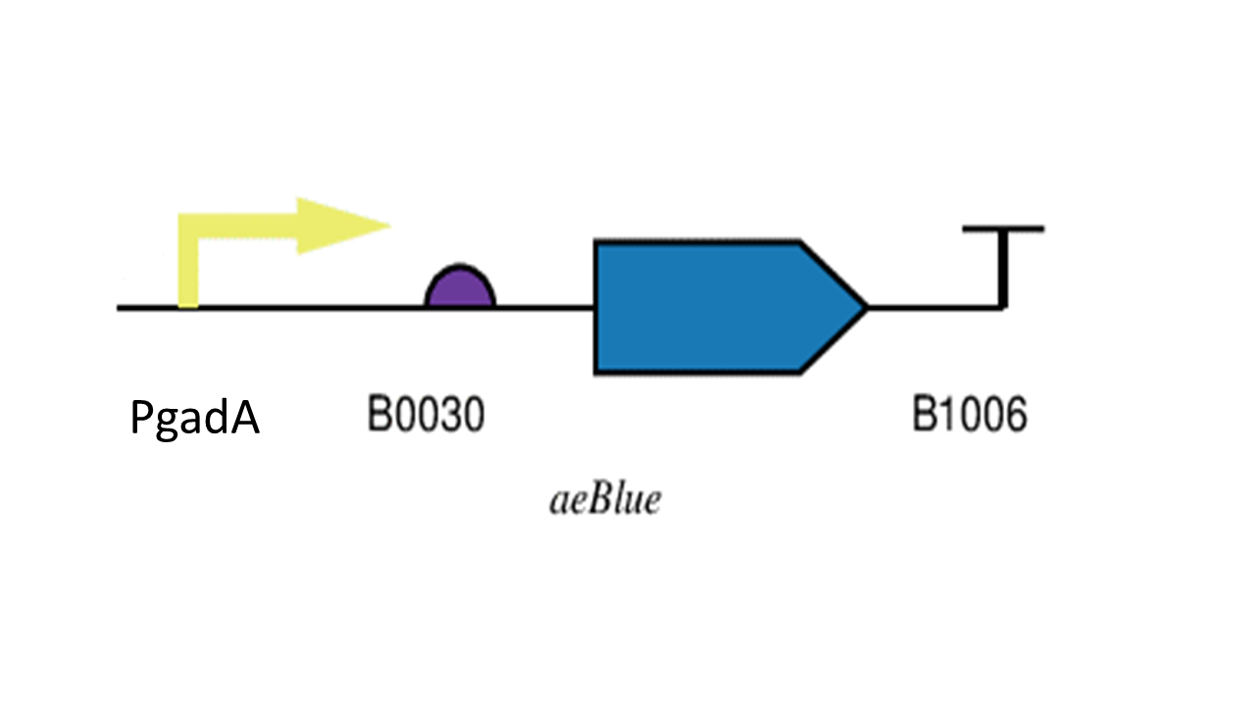
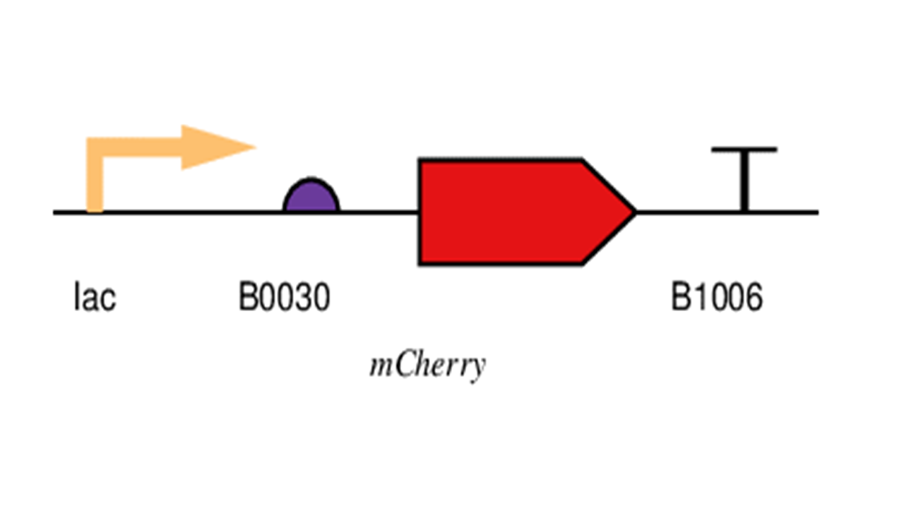
System
✔️
Positive and negative results: create some form of signal for both detection of polio and absence of polio
Accessible to majority of population: easy to understand results and accessible to color-blind
✔️
Notes:
Katie

Slide 10
Parts
System 1
Promoter: iGem part BBa_J23119
RBS: iGem part BBa_B0030
Coding Region: Human Poliovirus Receptor
Terminator: iGEM part BBa_B1006
System 2
Promoter: iGem part BBa_J23119
RBS: iGem part BBa_B0030
Coding Region: complement to the first 24 bp of poliovirus + lacI
Terminator: iGEM part BBa_B1006
Notes:
Katie

Slide 11
Parts
System 3
Promoter: lac operon
RBS: iGem part BBa_B0030
Coding Region: mCherry fluorescent protein
Terminator: iGEM part BBa_B1006
System 4
Promoter: lac operator
RBS: iGem part BBa_B0030
Coding Region: antisense of aeBlue protein
Terminator: iGEM part BBa_B1006
Notes:
Katie

Slide 12
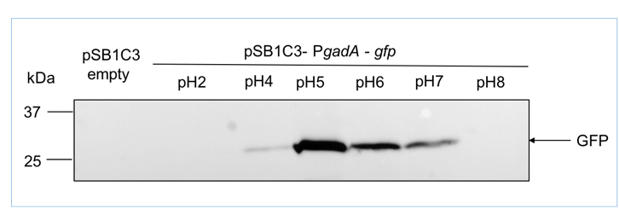
Parts
System 5
Promoter: PgadA
RBS: iGem part BBa_B0030
Coding Region: aeBlue
Terminator: iGEM part BBa_B1006
Notes:
Barbara

Slide 13
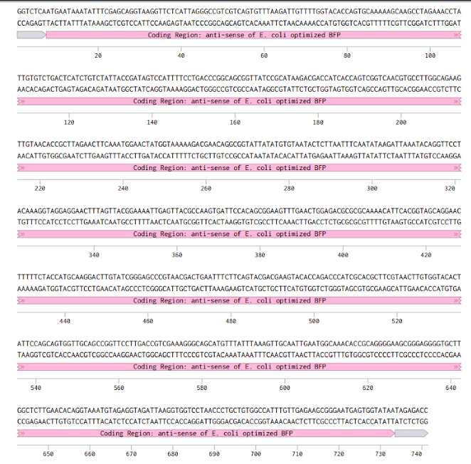
DNA
Coding regions: IDT Codon Optimizer Tool
Benchling Digest
BsaI cut sites added for cloning plan
Notes:
Katie

Slide 14
Build

Slide 15
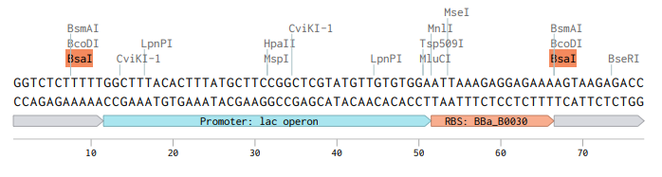
Cloning Plan
15 parts total: perform Golden Gate twice
Chosen to keep costs low while performing as few reactions as possible
Method: Golden Gate
Notes:
Katie

Slide 16
Evaluating Golden Gate Cloning
Pros
Up to 10 parts assembled in single pot reaction without purification
Simple, fast
Scarless
Only one restriction enzyme
Cons
Overhangs must be unique to prevent misassembly
Parts can’t have internal Bsa I sites in gene of interest
Parts need to be in appropriate format; relying on PCR
Notes:
Barbara

Slide 17
Genomic Integration Plan
Pros:
High efficiency
Accessibility to PAM sites in E. Coli
CRISPR with Lambda Red
Cons:
Necessity of PAM sites
Works best in eukaryotes
Notes:
Barbara

Slide 18
Test
Notes:
Adrian

Slide 19
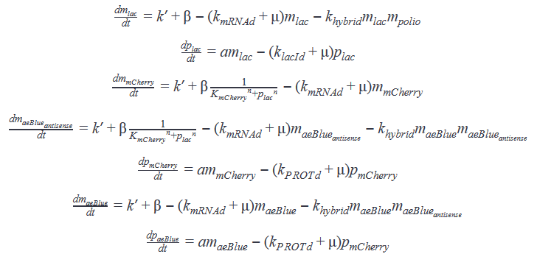
ODE for our System
Collection of first order kinetics, hill repression, and assumed second order irreversible hybridization kinetics
K_{mCherry} is very low
Notes:
Adrian

Slide 20
Model Assumptions
High protein expression
mRNA decay ~4min
Protein decay ~10-20min
mCherry and aeBlue: 20min
lacI: 10min
Protein decay:mRNA decay ~ 5
No secondary structure impending hybridization
Growth rate by the bacteria negligible
Strong RBS
Notes:
Adrian

Slide 21
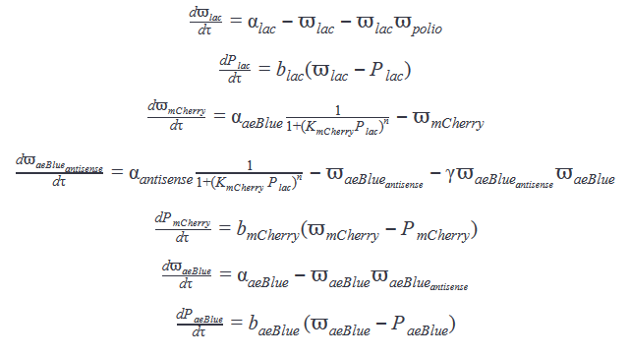
Normalization and Jacobian
mRNA | lacI | mRNA | mRNA | mCherry | mRNA | aeBlue
-1-m_{polio} | 0 | 0 | 0 | 0 | 0 | 0
b_{lac} | -b_{lac} | 0 | 0 | 0 | 0 | 0
0 | X_{lac} | -1 | 0 | 0 | 0 | 0
0 | X_{lac} | 0 | -1-ˠ | 0 | -1 | 0
0 | 0 | b_{mCherry} | 0 | -b_{mCherry} | 0 | 0
0 | 0 | 0 | -1 | 0 | -2 | 0
0 | 0 | 0 | 0 | 0 | b_{aeBlue} | -b_{aeBlue}
Normalized to make Jacobian and parameter searching easier
Notes:
Adrian
All parameters stable
Steady state values and switching function fucked. Parameter manipulation gucci

Slide 22
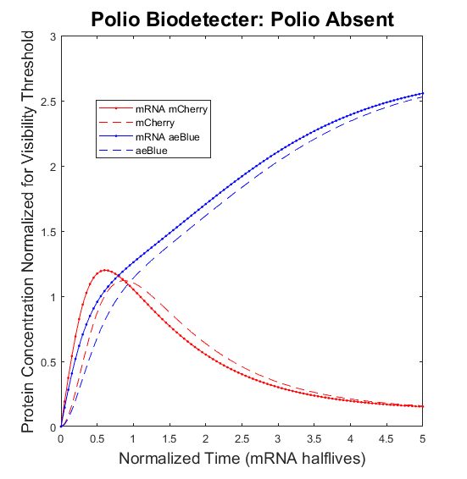
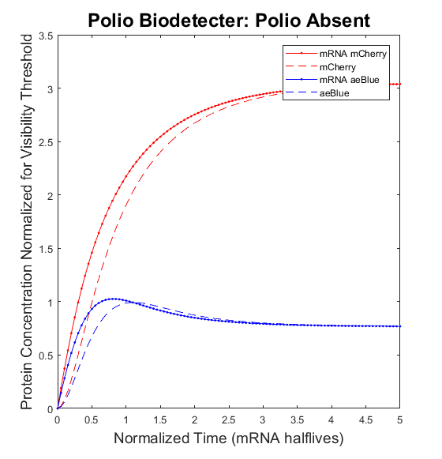
Final Graphs and Parameters
mRNA half-life is ~4 min
determined signal at least 8 min
confident steady state signal ~30 min
A
B
Simulated polio biodetector behaviour. A) Polio absent and aeBlue is expressed. B) Polio present and mCherry is expressed
✔️
Fast: report results in under one hour
Notes:
Adrian

Slide 23
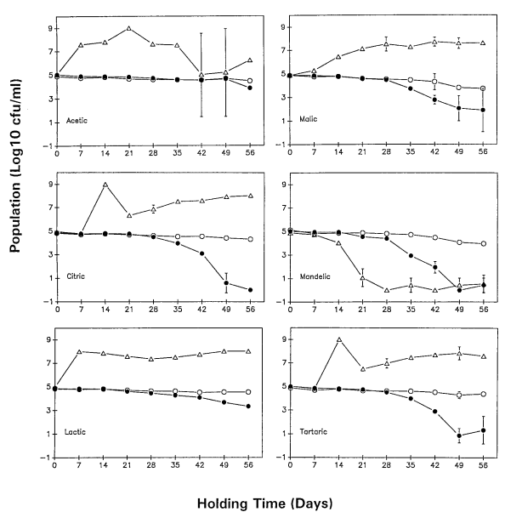
Design
Inactivate system during shelf life
Lactic acid to reduce pH to control E. coli population in reasonable temperature range
Shelf life of at least 56 days in acidic conditions
Appropriate fill level lines for volumes of water (start test) and bleach (kill system)
of the Larger System
Conner, D., & Kotrola, J. (1995, January). Growth and Survival of Escherichia coli O157:H7 under Acidic Conditions. APPLIED AND ENVIRONMENTAL MICROBIOLOGY, 61(1), 382-385.
Notes:
Barbara

Slide 24
Learn
Notes:
Barbara

Slide 25
Design Improvements
L*a*b colorimetric measurements
Troubleshooting common user errors
Varying water volumes and therefore varying pH
Sediments or other foreign materials
Notes:
Barbara

Slide 26
Conclusions
Notes:
Barbara

Slide 27
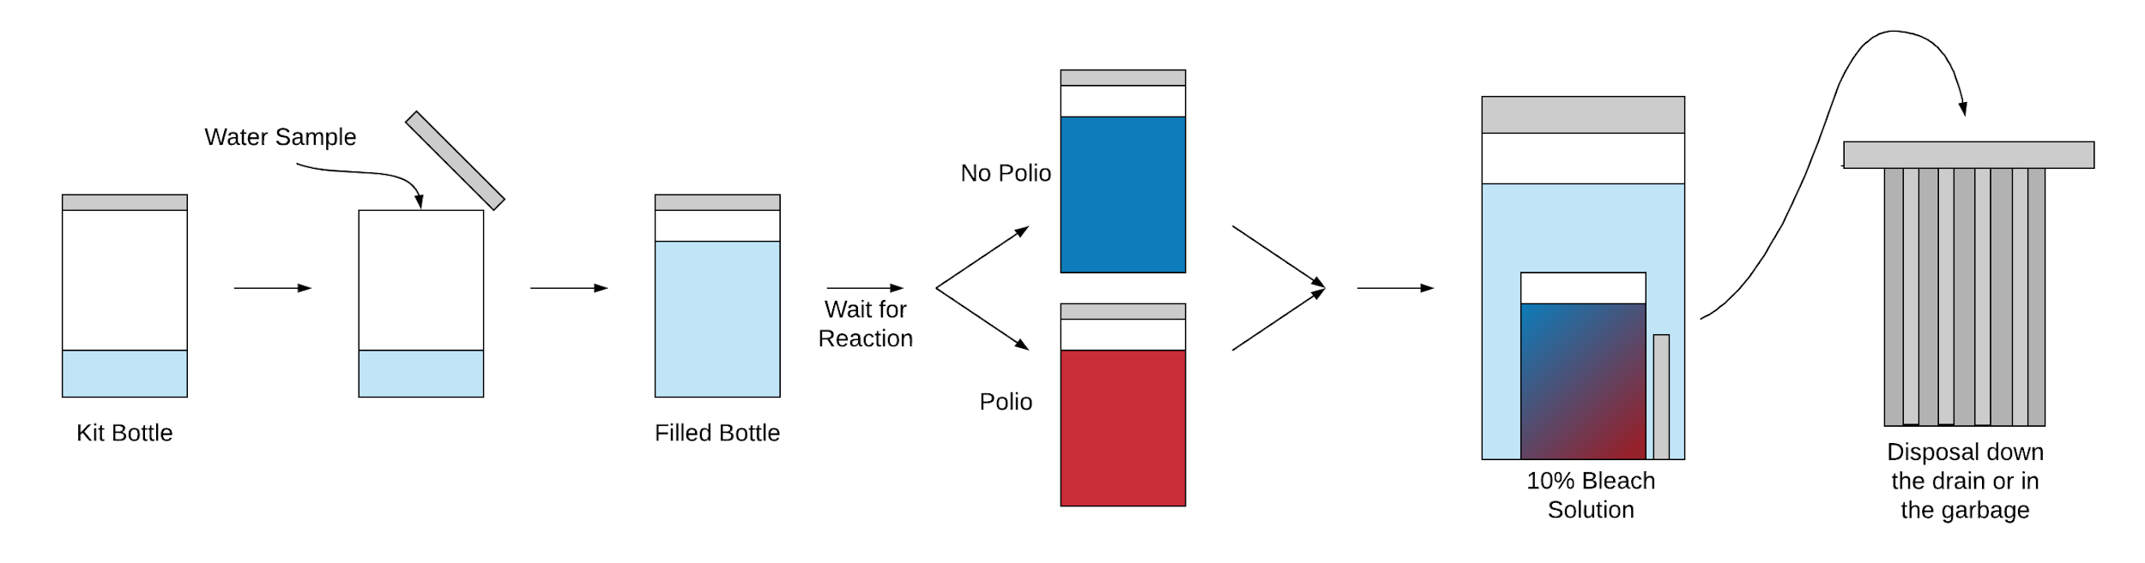
Final Product: A Home Water Test to Detect Polio
✔️
User-friendly: must be able to be used and understood by people without any training and can be performed at home without uncommon equipment
Notes:
Barbara

Slide 28
Measurement of Project Success
✔️
User-friendly: kit comes with all materials needed besides water to be tested and instructions for performing the test and disposal
Fast: report results in about thirty minutes
Positive and negative results: blue signal if there is no polio, red signal in the presence of polio
Accessible to majority of population: blue/red combination accessible to the color-blind population
✔️
✔️
✔️
Notes:
Archana

Slide 29
Responsible Science and Ethical Considerations
Biosafety: kit comes with method for safe disposal so that the contaminated water nor the engineered bacteria is introduced to the outside environment
Biosecurity: unlikely harmful repurposing
Justice and Fairness: ideally sell the product to the government and distribute to citizens for free so that anyone can test water regardless of income
Eugenics: unlikely backlash from engineering E. coli
Notes:
Archana

Slide 30
Bibliography
[1] “Travelers' Health,” Centers for Disease Control and Prevention, 26-Oct-2018. [Online]. Available: https://wwwnc.cdc.gov/travel/notices/alert/polio-nigeria.
[2] “Nigeria,” GPEI. [Online]. Available: http://polioeradication.org/where-we-work/nigeria/.
[3] “Led by Nigeria, Africa opening door to genetically modified crop cultivation,” Genetic Literacy Project, 12-Jan-2018. [Online]. Available: https://geneticliteracyproject.org/2017/03/06/led-nigeria-africa-gradually-opening-door-genetically-modified-crop-cultivation/.
[4] G. Williams, F. Taylor, I. I. Odidika, and K. Amusa, “Frequency of color blindness among Nigerian school children in Lagos,” American Journal of Human Biology, vol. 10, no. 3, pp. 283–288, 1998.
[5] Conner, D., & Kotrola, J. (1995, January). Growth and Survival of Escherichia coli O157:H7 under Acidic Conditions. APPLIED AND ENVIRONMENTAL MICROBIOLOGY, 61(1), 382-385.

Slide 31
Questions?

